Slide 1
Resampling
Class # 13
October 15, 2019

Slide 2
Talk about order to split up data
Talk about *why* we do loo, k-fold
Salma related to bootstrap in which we randomly resample WITH replacement

Slide 3
Announcements
HW5 due today
HW6 will post today –
Reading for today: ISLR 5.1-5.2
Reading for Thursday
ISLR 6.1-6.2
Metz (NYT 2019; see readme in github reading folder for this day)

Slide 4
Resampling
What you can do with resampling:
Model assessment
Model selection
Measuring the accuracy of parameter estimates
Parameters can be model coefficients
But they can also be other quantities you’d like to compute with the model.
When you’ll (most likely) use which method:
Cross validation for model assessment and selection
Bootstrapping for measuring parameter accuracy

Slide 5
A side note on terminology…
In ISLR, resampling means repeatedly pulling sub samples from your data.
If your data are a sample from the population, then we’re creating new samples from the original.
But in pandas, resampling can also mean aggregating your data,
e.g. taking all data from a particular time window and averaging them.
We’ll see this in the notebook today.

Slide 6
A little more on model selection
So far we have mostly focused on model identification, or the process of choosing model parameters.
But we also used AIC to do model selection, i.e. to learn which type of model we should use.
AIC works for OLS specifications.
But what about KNN and all the other methods we’re about to learn?

Slide 7
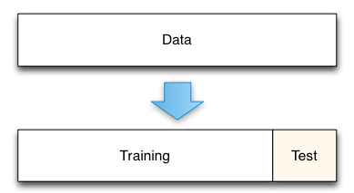
Test and Train data
We’ve already talked about the power of training and testing data
Testing data a.k.a. “holdout data” and “validation data”
If you just split the data once:
Your error rate may depend strongly on the characteristics of the random split
You’re only using a fraction of the data for validation.
Notes:
Image source: Kaggle.com

Slide 8
Leave One Out Cross validation…
Allows you to use all the data for testing / validation
Provides one estimate of the test error.
Fig. 5.3 from the text:
The basic idea is to repeatedly split the data such that you “leave out” each observation once.
Use remaining observations to train a model
Use left-out observation to compute a test error
Do this n times!

Slide 9
Leave One Out Cross validation (LOOCV)
For all i, pull the observation (x_{i}, y_{i}) out and fit the data to the remaining data.
Call the estimate of y_{i} from the “one-left-out” model y_{i}
Then MSE_{i} = (y_{i} - y_{i})²
Then the error estimate for this “leave one out” process is
…where the sum is over all n – i.e. n models were fit, each time fitting a different subset of the data.
Note the subscript on CV is n because we split the data n times

Slide 10
LOOCV advantages to using just one split
Test error when you split just once tends to overestimate error more than LOOCV
This is because you use more data to fit each model with LOOCV
By using every possible split, there is no variation in the estimate of error.
On the other hand, if you use just one validation set, the error depends strongly your random split.
For some special cases you don’t even need to do the resampling
See Equation 5.2

Slide 11
k-fold cross validation
Randomly divide the set into k equal groups
k ≤ n
LOOCV is n-fold cross validation
Compute the test error MSE_{i} for each group. This will be the average of errors for all withheld observations in the group.
Then:
Why do this?
Only k folds (rather than n) – computationally easier

Slide 12
Test with training data
10 different validation data sets
Validation can be used for model selection.
The “best” model is the one with the lowest MSE for test data
In these figures (Auto data set from the book) the minima are in different locations for different validation approaches
10-fold: each line is a different random split into 10 folds.

Slide 13
k-fold on classification problems?
Yep, pretty simple to extend. Here it is for n-fold (LOOCV)
Where Err_{i} is the error rate (misclassified / total)

Slide 14
What should k be?
The answer can be based on the bias variance tradeoff
LOOCV has lower bias than k-fold,
But LOOCV MSE variance tends to be larger than k-fold CV.
Rule of thumb: k = 5 to 10.

Slide 15
Let’s look at today’s notebook.
Here is the interact link.

Slide 16
The Bootstrap
Standard error -- what is it?
A measure of the average difference between an estimate of a parameter from the true value of the parameter.
Standard errors can be computed with simple formulae in some cases, for example for coefficients fit using ordinary least squares (OLS) regression
However for many other cases there is no simple formula
When the assumptions required to apply the formulae don’t apply, even if you’re doing OLS
For example if your errors are strongly correlated
When you’re using a different algorithm to fit your model, for example linear discriminant analysis.

Slide 17
Computing the standard error numerically
If you can’t directly apply a formula to compute the standard error, you might be able to use your computer to construct the distribution
You could draw new sets of samples from your population repeatedly and recompute the parameter of interest
For example draw a set of N = 100 observations and repeat B = 1,000 times
The average parameter estimate across the B draws will be the true parameter, and you can measure the standard error from the distribution of parameter estimates
But! We can’t usually repeatedly sample from the true population
You can’t go out and re-survey a new set of 100 randomly chosen 1,000 times (or else you’ll never graduate!)

Slide 18
Enter the bootstrap
First key idea: create a new sample from your original sample by sampling with replacement.
Repeat this B times
Record the parameters you care about each time
The average parameter estimate will equal the true parameter
Second key idea: the standard error of the parameter estimate will be roughly the true standard error.

Slide 19
In other words…
Say it again: the standard error of the bootstrapped parameter estimates is a decent approximation of true standard error.
“The population is to the sample what the sample is to the bootstrapped sample”
How many in the sample? How many samples?
N = (Rule of thumb) Make your samples equal in size to the original sample
B = (Good practice) keep generating new samples until your estimates (parameter average and standard error) converge

Slide 20
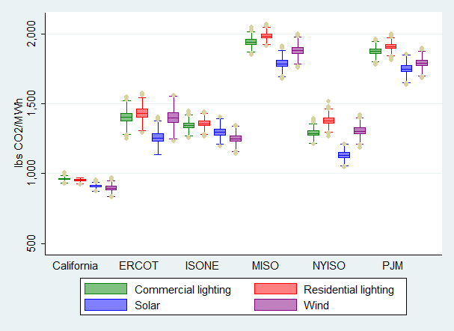
What can I bootstrap?
This is one of the advantages of bootstrapping: anything you might want to calculate from your data, you can bootstrap.
You don’t need to limit yourself to regression coefficients
Example: bootstrapped estimates of CO2 avoided by implementing various technologies in different locations (Callaway, Fowlie and McCormick, JAERE 2017)

